Slide 1

Diamond Field-Emission Cathodes as High-Brightness Electron Sources
Bo Choi, Jonathan Jarvis, and Charles Brau
Vanderbilt University

Slide 2
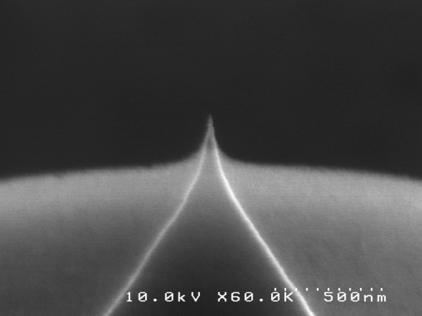
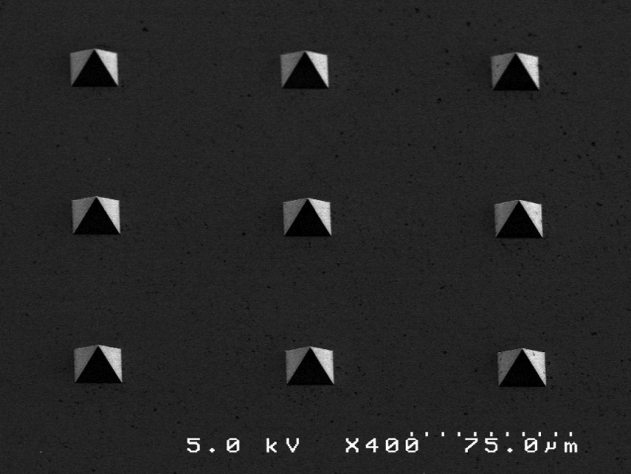
Diamond Field Emission Cathode
DFEAs are rugged alternative to photocathode
  The cathodes are not damaged by exposure to air.
  Operating vacuum: <10⁻⁶ torr
  Fowler-Nordheim turnneling
  Max. current: ~10 uA per tip
  Designable parameters: density and height
Individual emitters have exquisitely small emittance

Slide 3
Ungated Diamond FEA fabrication procedure
All in-house capable with VINSE facilities
Preliminary field emission test (DC) can be performed for screening before delivery

Slide 4
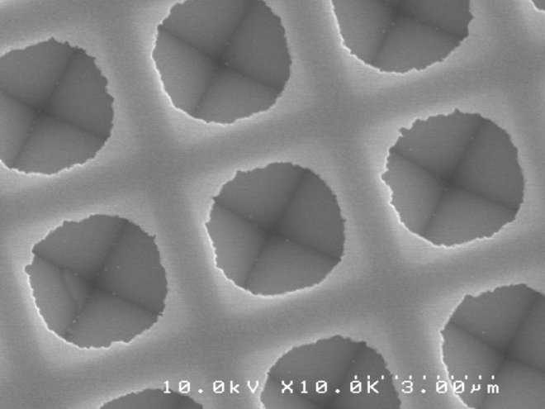
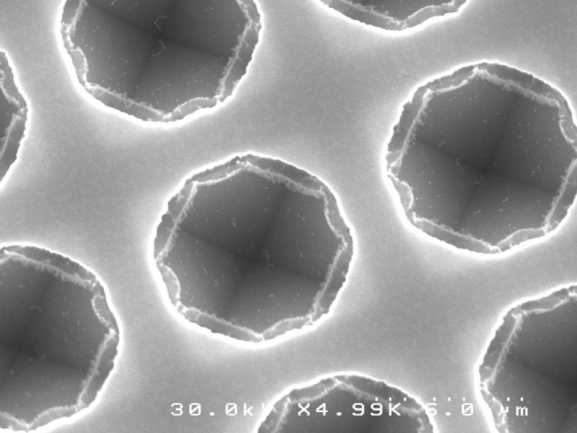
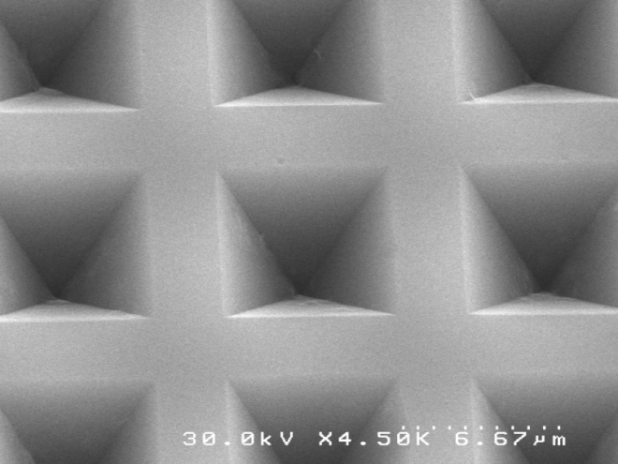
Pyramidal mold fabrication by KOH etch
Cr/ SiO₂ hard mask
Cr hard mask
100 nm Cr layer or 300 nm SiO₂ layer works fine for up to 5 um base pyramidal molds
Final reverse pyramidal molds

Slide 5
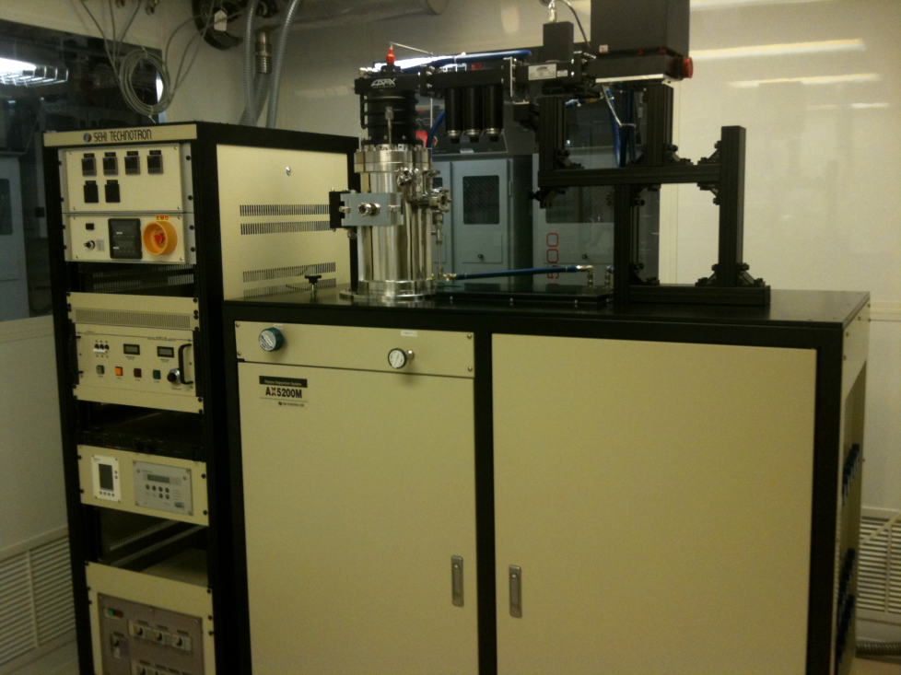
Microwave Plasma CVD system provides reliable diamond growth
SEKI AX5200M
  Water cooled induction heating stage
  Custom-designed susceptor cover
  DC bias module
  Turbomolecular pump
  Low substrate temperature
  Optimum plasma location
Results
  Higher film quality
  Repeatability
  Uniformity (2 inch)

Slide 6
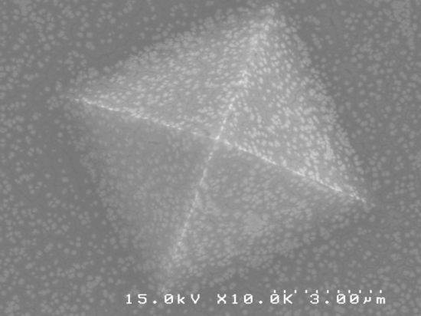
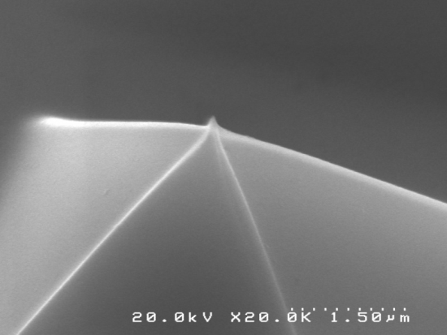
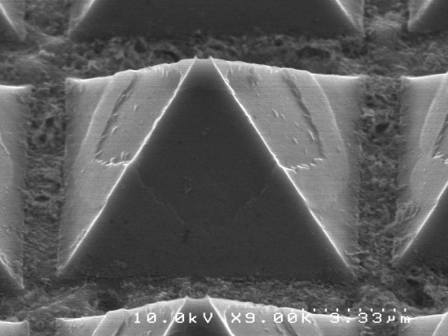
Bias-enhanced nucleation (BEN) improves surface structure of nanodiamond
Shallow ion implantation (carbon cluster)
200 V 20 min. – 30 min.
Initial nucleation current: 70 – 100 mA around 2 inch area
Nucleation current drops by 20 % during nucleation
Sonication with diamond powders is still used before BEN
10 min
30 min
60 min

Slide 7
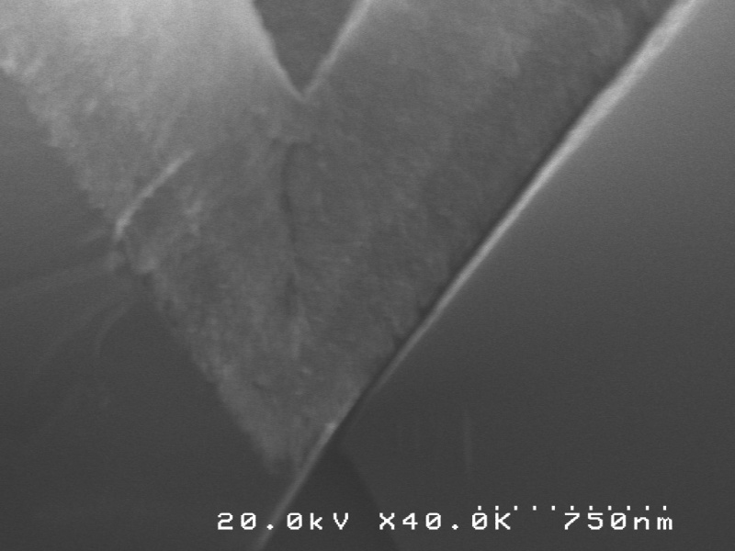
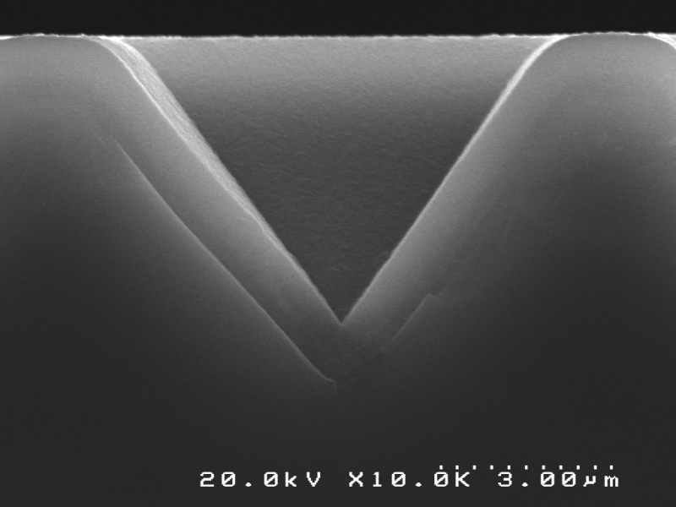
Diamond Deposition Recipes (I: nanodiamond)
First layer of pyramid is nanodiamond
  Substrate : 650 deg. C
  Microwave 700 W
  20 Torr
  H₂ 300 sccm/ CH₄ 15 sccm/ (N₂ 15 sccm)
Nanodiamond
N₂ Doped layer
Nanodiamond
SiO₂
Si

Slide 8
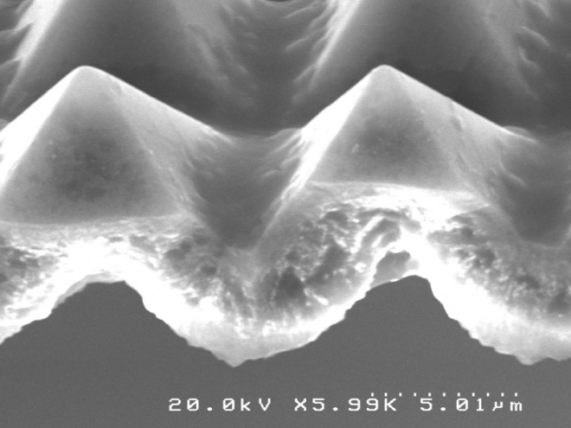
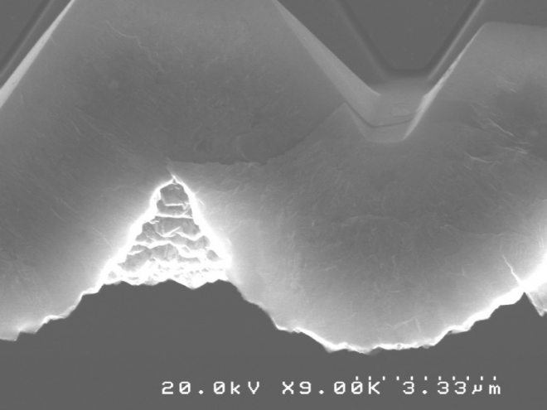
Diamond Deposition Recipes (II: microdiamond)
Interior of pyramid is filled with microdiamond
  Substrate : 650 deg. C
  Microwave 1300 W
  50 Torr
  H₂ 300 sccm/ CH₄ 3 sccm

Slide 9
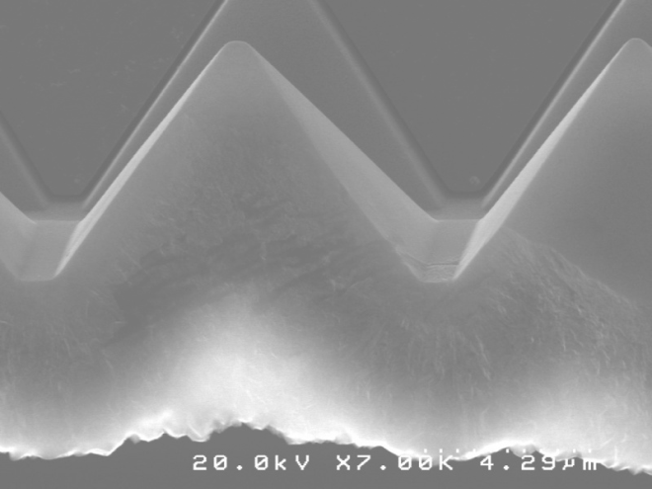
Brazing system
Requirements
  Vacuum brazing for gap filling
  Uniform over 2-inch diameter
  Best adhesion with diamond and Mo
Solutions
  Vacuum hot plate
  Ti-Cu-Ag alloy needs over 800 deg. C to melt
  Polishing
  Optimizing thermal loads
Si
Nanodiamond
Microdiamond
Ti-Cu-Ag Alloy
Mo Plate

Slide 10
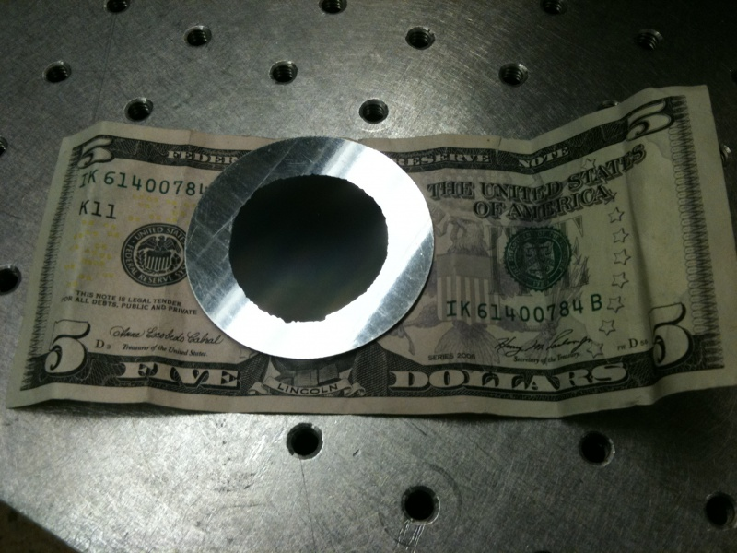
Brazing apparatus and techniques make possible larger cathodes and improved yield
Three points holding by spring clips
Polished Mo Heater block
Polished and cleaned Mo plates

Slide 11
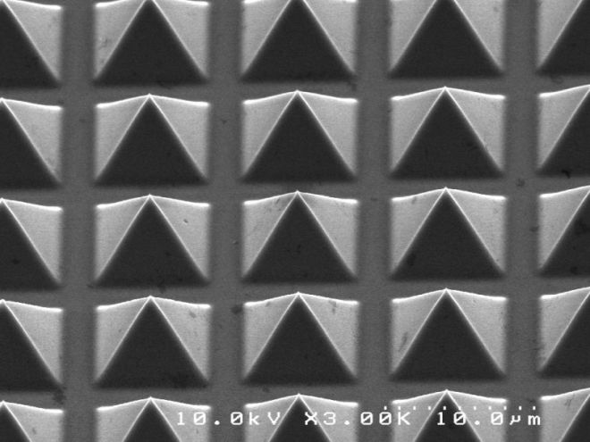
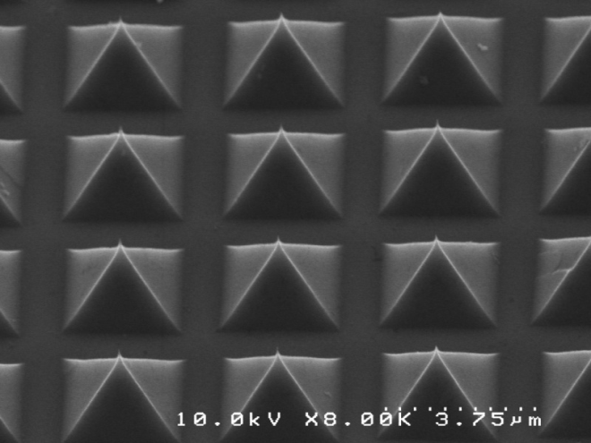
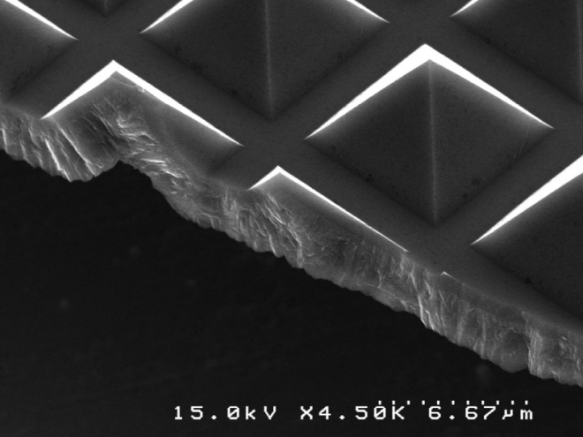
Improved fabrication techniques produce large, uniform arrays with improved yield
7 um pitch
Thin diamond layer allows brazing of large arrays
Requires no additional edge treatment:
4 um pitch

Slide 12
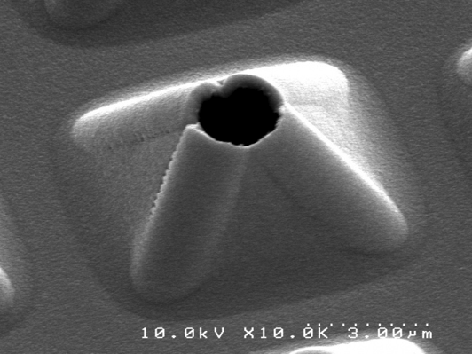
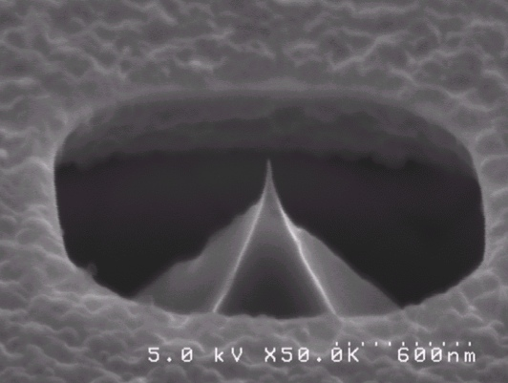
Gated Diamond FEA fabrication procedure
Volcano process
SOI process

Slide 13
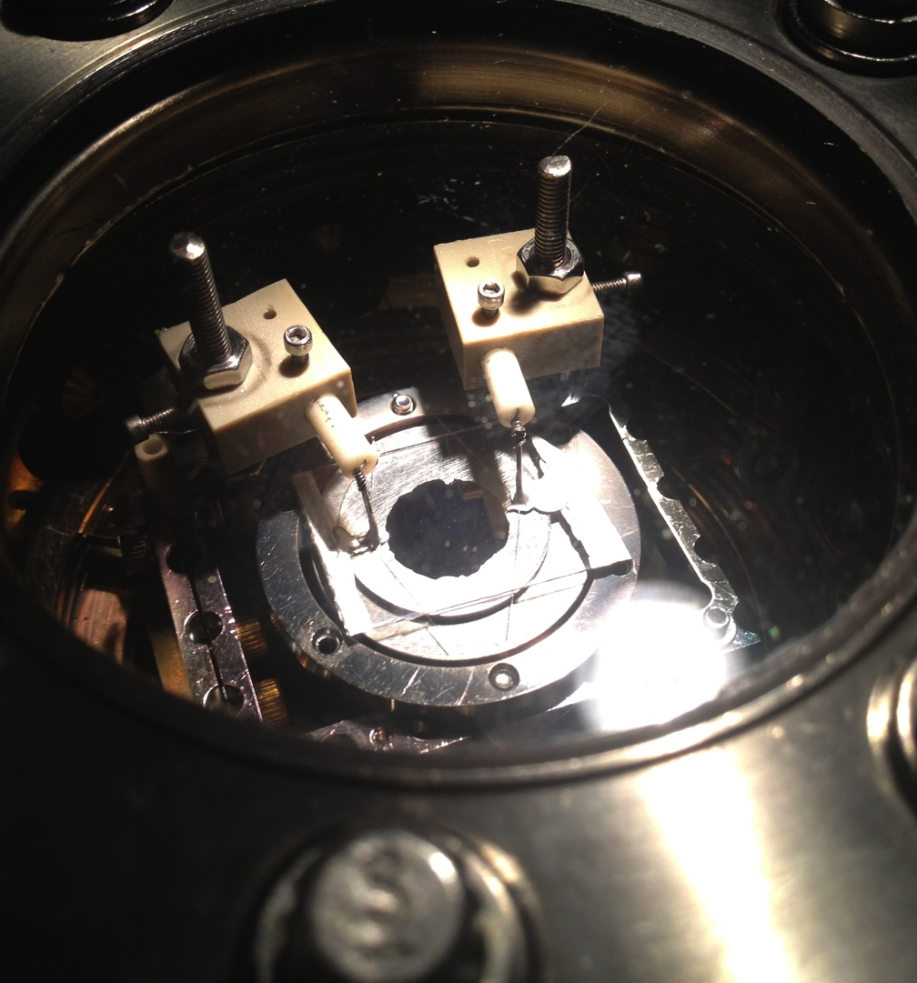
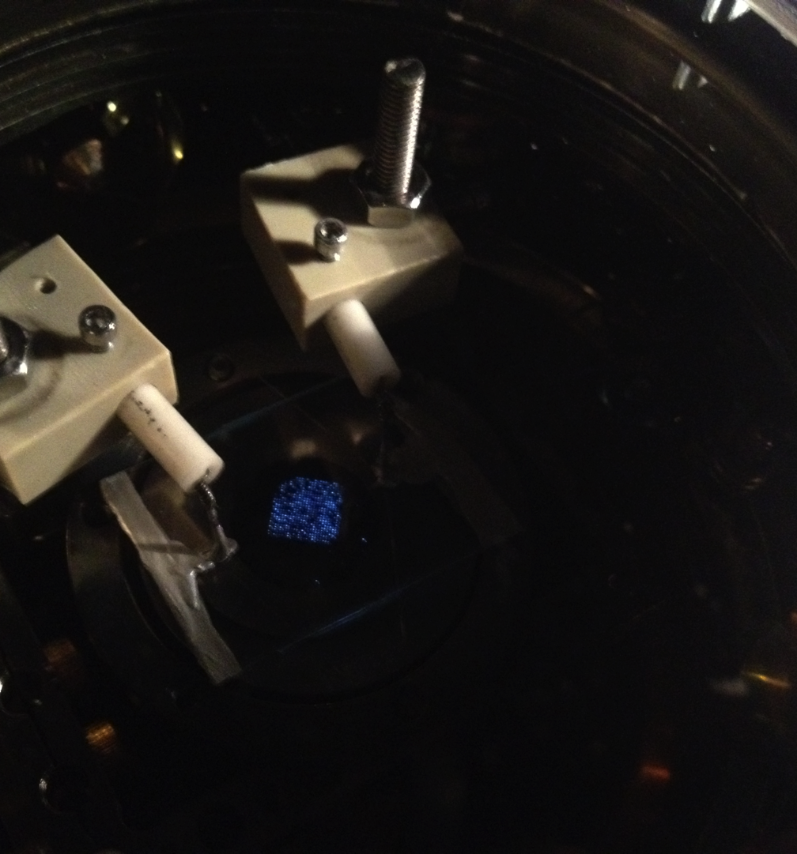
Preliminary DC test

Slide 14
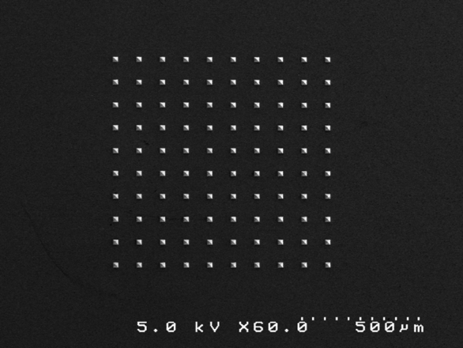
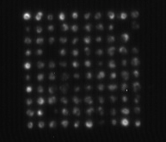
Excellent uniformity after hitting >1uA/tip

Slide 15
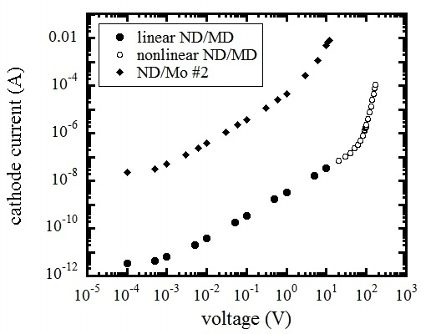
Conduction through diamond film and FN tunneling
I-V characteristics across diamond films
FN tunneling behaviors across a vacuum gap

Slide 16
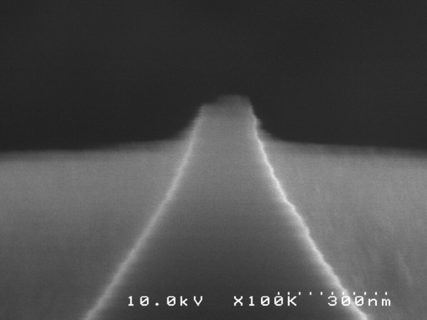
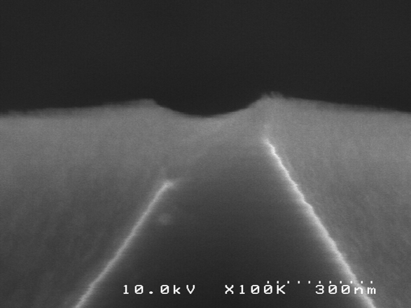
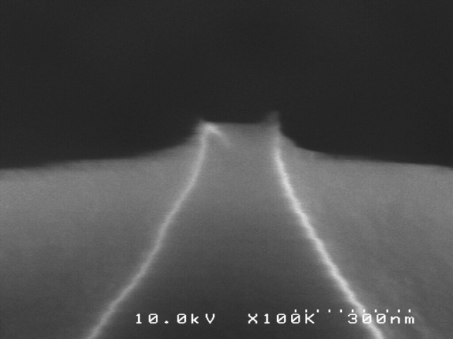
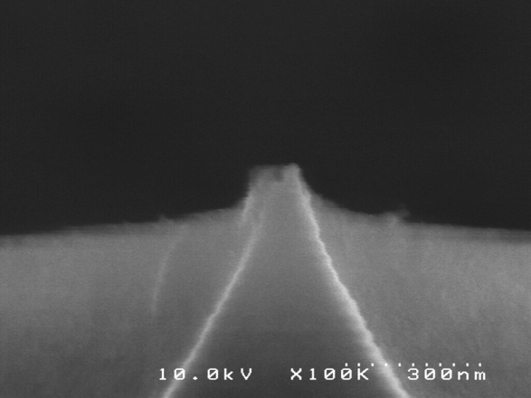
Uniformity: dark spots

Slide 17
Emittance test result
the normalized rms transverse emittance for a 1-cm diameter cathode array is 9.28 mm-mrad at 2.1kV: pepperpot 50um, L~3.56mm.

Slide 18
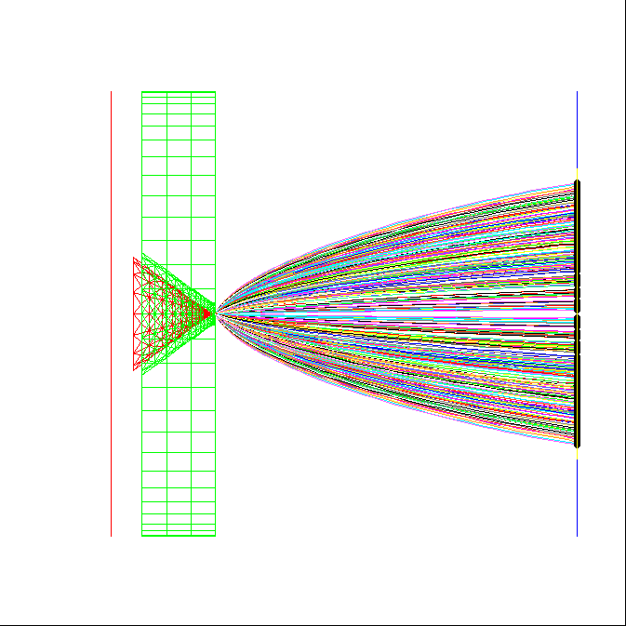
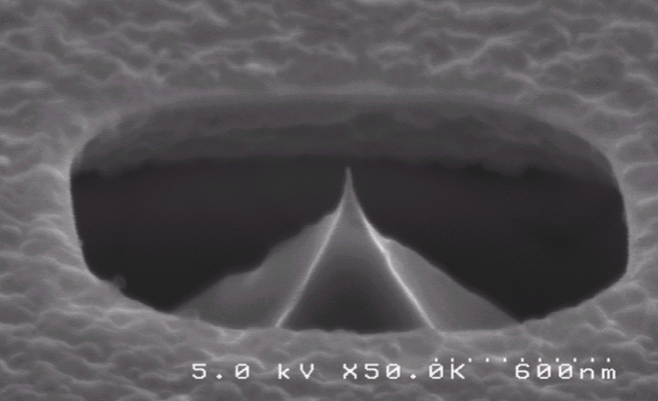

Individual field emitters provide electron beams with exquisite brightness
Diamond tip and self-aligned gate comprise monolithic structure
Tip radius ~6 nm
Tip current is switched by ~70 V gate bias
Measured current ~ 15 μA
Simulations indicate normalized emittance ~ 1.3 nm
  Mostly spherical aberration
Heisenberg limit ~ 1 pm possible from ungated tip

Slide 19
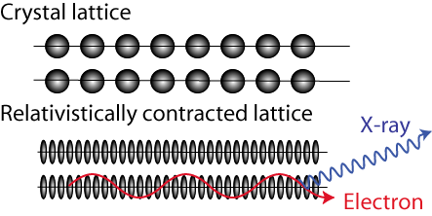
Channeling radiation from tightly focused electrons produces brilliant, hard X-rays
MeV electrons in crystals produce channeling radiation
Theory and experiments are well established
Hard x-ray emission possible from a diamond chip
  70-keV photons from 35-MeV electrons
  Requires modest rf linac
High spectral brilliance requires exquisite electron beam emittance
  10¹² ph/s/μm²/0.1%BW
  Requires
  200-nA average current
  1-nm normalized emittance
  40-nm focal spot on diamond
These parameters have never been explored in an rf linac
  Propose new type cathode
  Explore emittance growth
    Theory/simulation
    Experiment
Notes:
Dresden group showed everything agreed with theory.

Slide 20
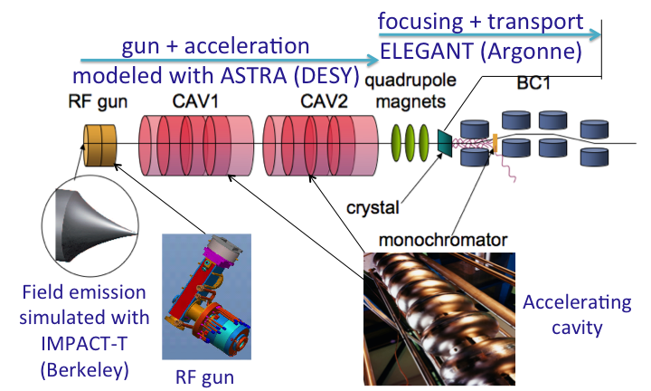
Simulations use several codes to describe different sections of x-ray source
Cathode modeled with IMPACT-T
Backed up by CPO
Rf sections modeled with ASTRA
  Backed up by PARMELA
Focusing modeled with ELEGANT
  May add GEANT inside diamond
Calculations done by
  NIU/Fermilab
  Vanderbilt
  Lewellen
  Pasour

Slide 21
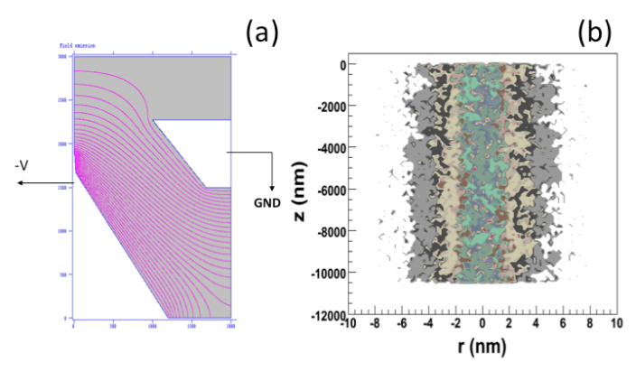
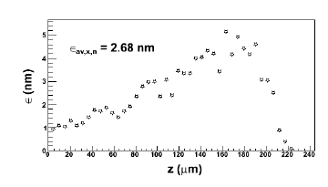
Computer simulations of field emission show exquisitely small emittance is possible
IMPACT-T (Piot, Mihalcea)
CPO (Brau, Jarvis, Ericson)
Codes agree
  Few nm emittance (2.7 nm)
Space charge negligible:
  space charge calculation with a mean-field and apoint-to-point space charge algorithms give similar results as single-particle calculation.
Slice emittance with pulse
Notes:
Wakefield effect … thermal and other, like diamond heating…. Phonon scattering….. GEANT

Slide 22
CPO simulations confirm small emittance
CPO uses different computational methods
Has been tested against experiments
Computed emittance of gated emitter is 2 nm
CPO will be used to design cathodes for test at VU and use at Fermilab

Slide 23
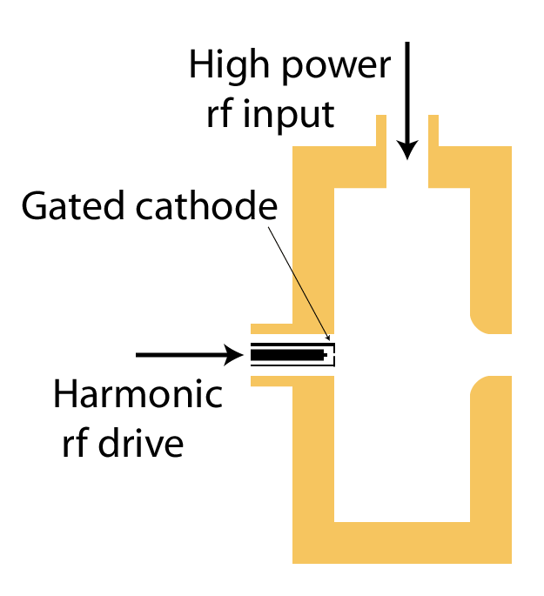
FE cathode in rf gun
Gate the cathode with dc, fundamental, and third-harmonic bias
Advantages:
  Simple gun and rf power exist at HBESL
  Emission amplitude and phase decoupled from cavity field
Disadvantages
  Complex cathode
  Possible spherical aberration

Slide 24
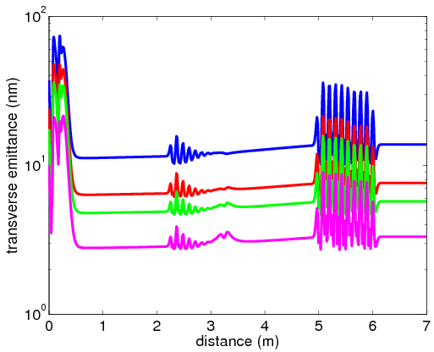
Emittance preservation during acceleration to 40 MeV
Simulation of gated
cathode in the an RF
gun followed by a LINAC
Transverse emittance ~10 nm is preserved during acceleration
Longitudinal emittance
increases due to the long bunch (distortions)
Transverse emittance evolution along beamline
for different fraction of the beam population
Q_{total}=25 fC
100%
95%
90%
80%
gun
CAV1
CAV2

Slide 25
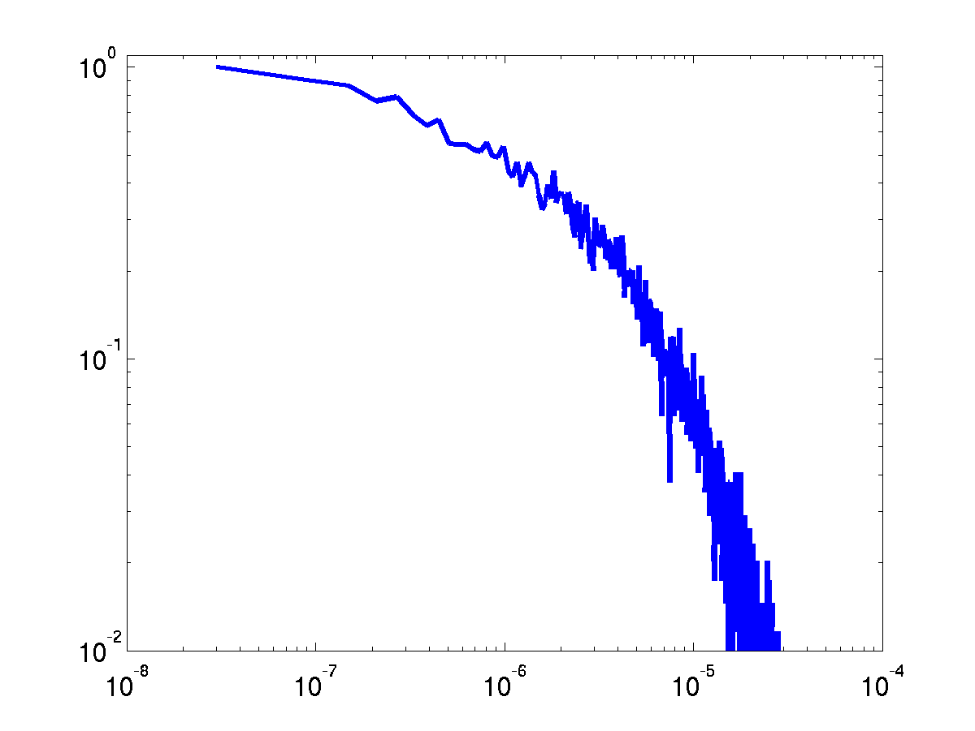
Optimization of focusing will be carried out using the code ELEGANT
Focusing limited by chromatic aberration
  Energy spread caused by “long” pulse length in rf cycle
  This is not a fundamental limit: in an optimized accelerator one would use a higher-frequency rf system to linearize the longitudinal phase space
Preliminary simulation for Q_{total}=25 fC
~500-100 e- are within 50 nm spot size
Normalized population)
x (m)

Slide 26
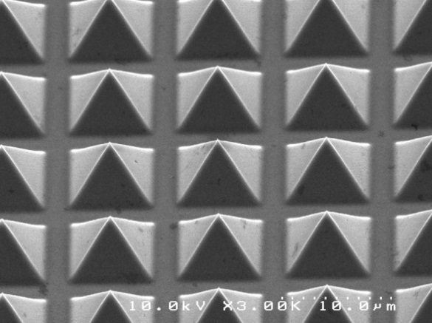
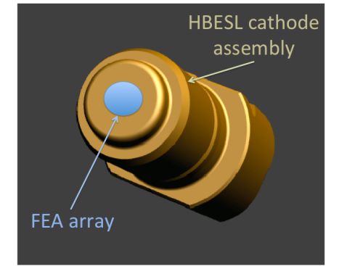
Simulations look very promising, so now we hope to do experiments on A0 injector this year
First experiments will use ungated cathode array
  Array brazed directly to cathode plug of A0 gun
  Cathode in fabrication at Vanderbilt
Ungated array will not have good emittance
  Might be useful for early x-ray experiments

Slide 27
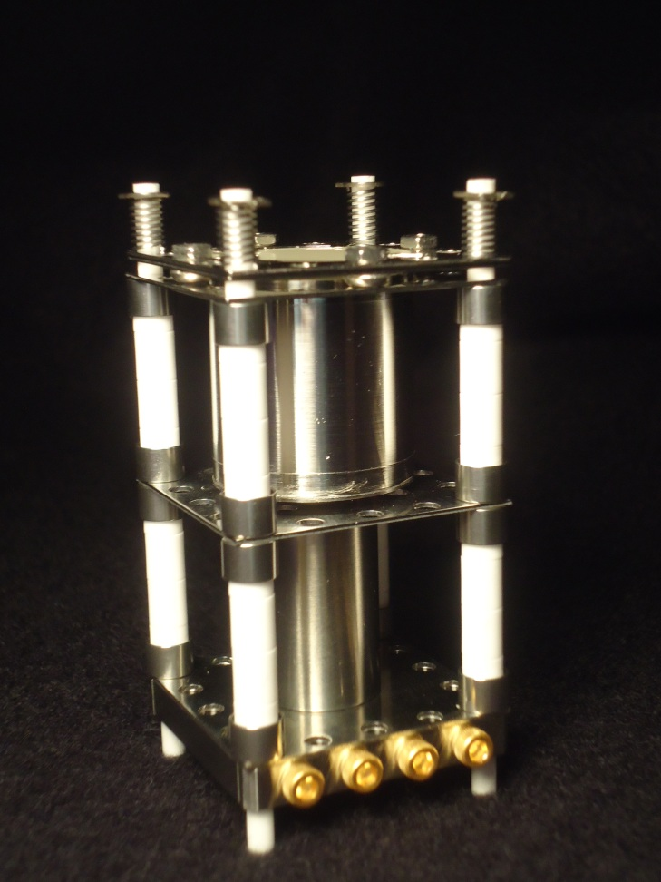
As they are fabricated, cathodes will be tested at Vanderbilt in small DC test stand (mini-gun)
Test stand developed for Navy program
Measure “transistor characteristics”
  I-V with gate control
  Maximum current
  Data for tests at A0
Measure divergence
  Estimate emittance
  Too small to measure

Slide 28
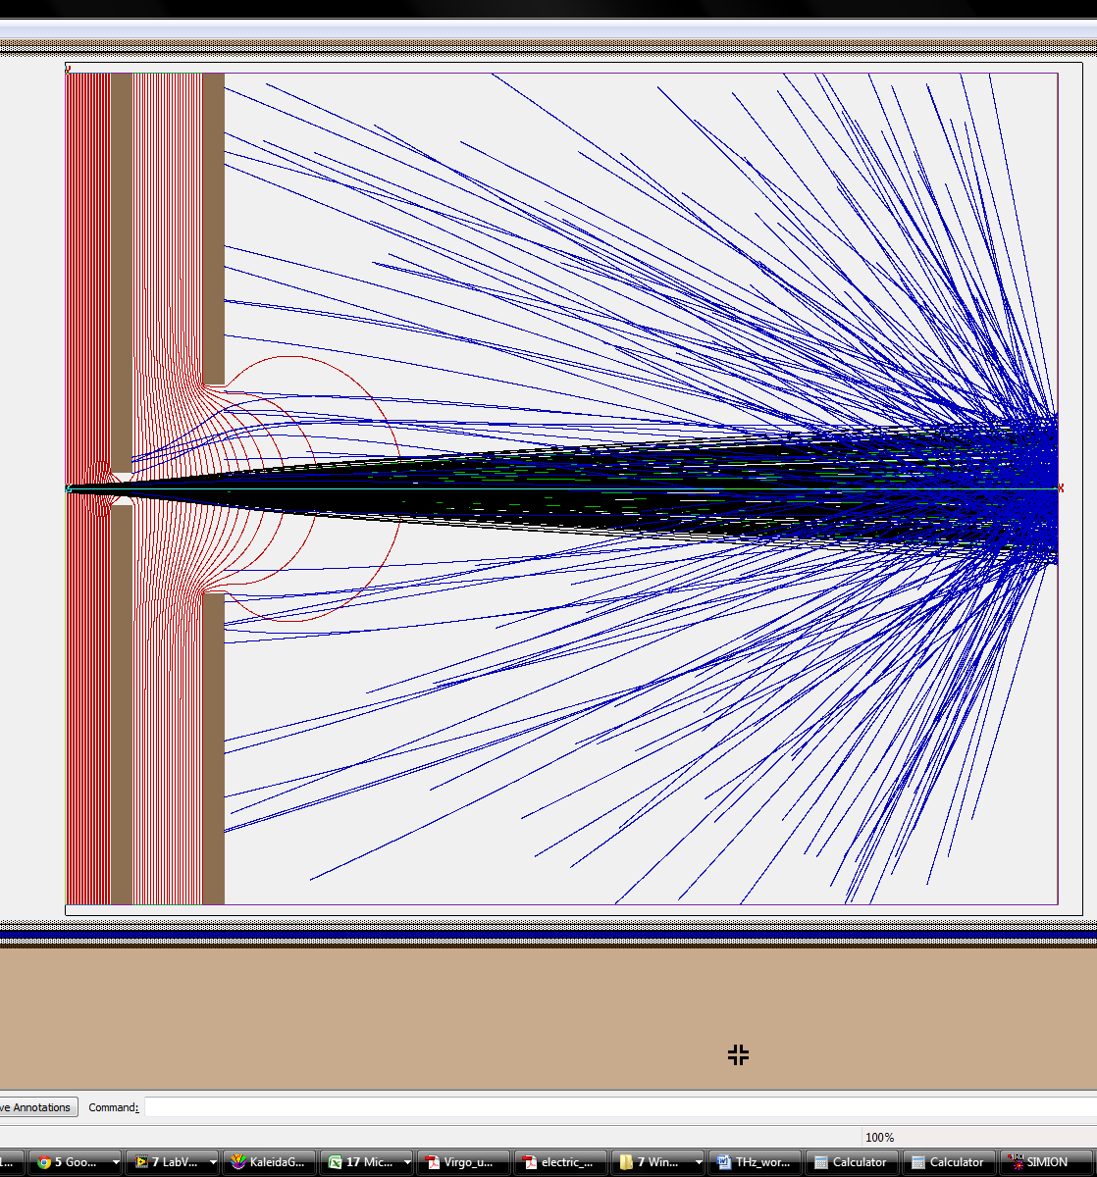
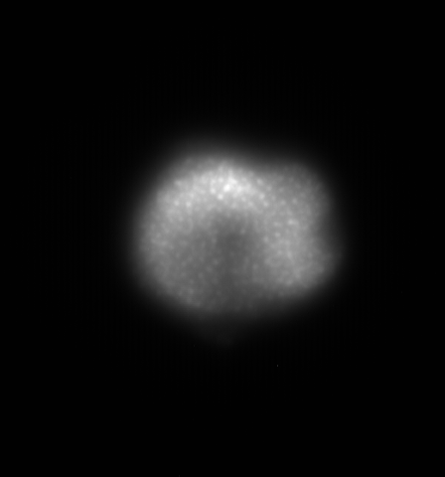
Simulation and result of minigun

Slide 29
Summary
Diamond is the hardest substance
Diamond FEA shows high-brightness in DC test
Rf gun test is on going with Fermi Lab. and Niowave
Gated structure is under way
Conduction mechanism through diamond and field emission mechanism are not clearly understood yet

